Slide 1
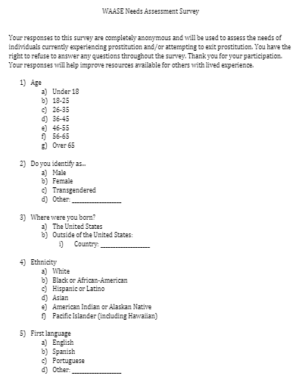
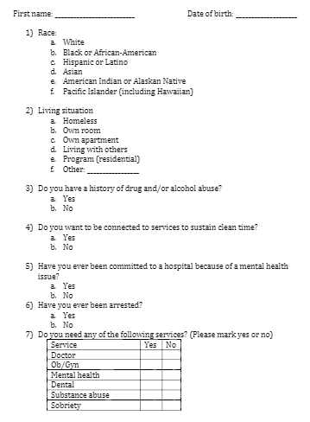
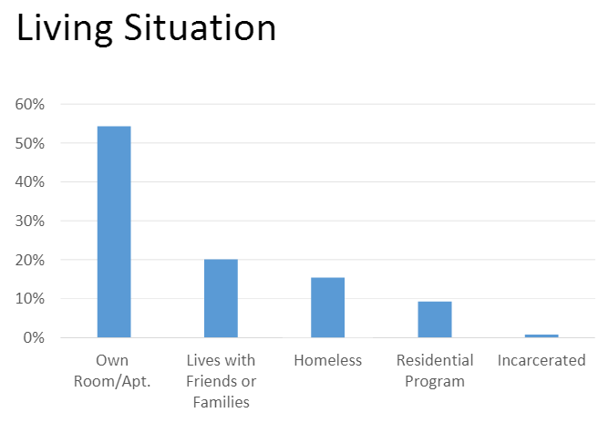
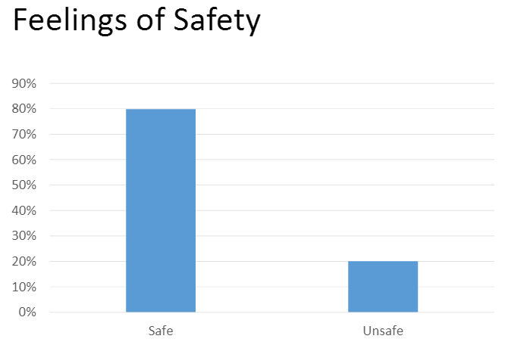
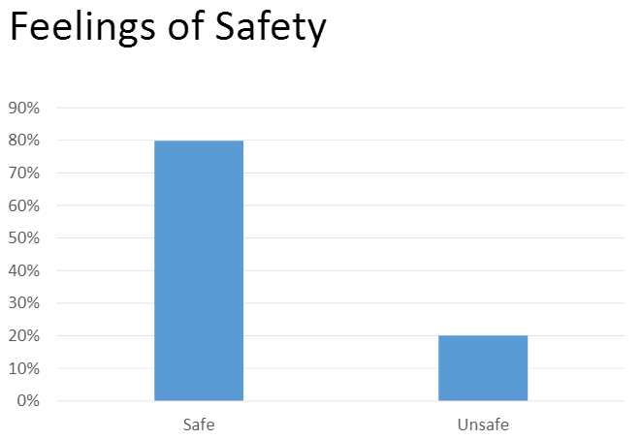
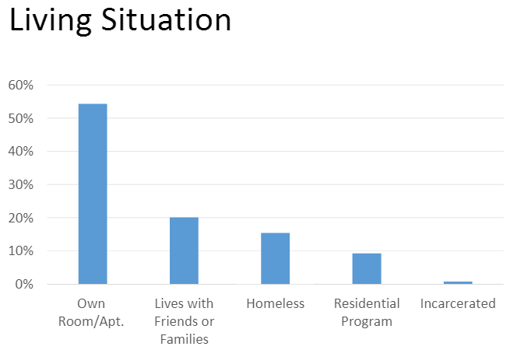
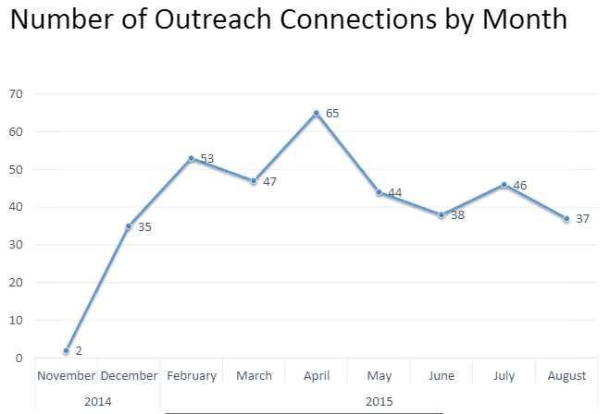
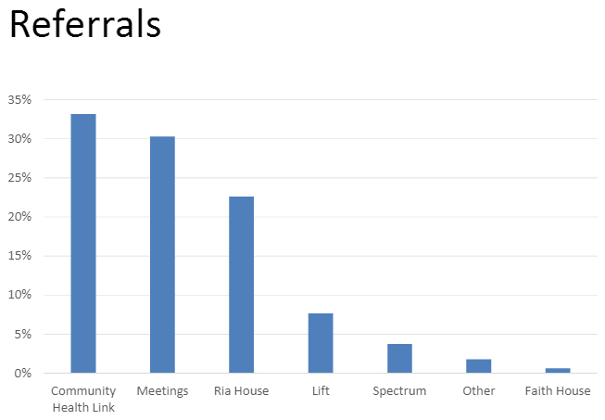
THE WORCESTER ALLIANCE AGAINST SEXUAL EXPLOITATION:
DRAFT NEEDS ASSESSMENT SURVEYS
Anika Berger, Jessica Macey, Aidan Ottoni-Wilhelm
Clark University, ID106-Healthy Cities
Problem Statement
WAASE currently lacks a needs assessment survey. What is currently used was designed as an outreach log, not a needs assessment or a method to capture data. As a result, the information gathered lacks consistency and standrdization.
Current Data Capture
Proposed Tool
The revised assessment is a standardized instrument to gather more consistent and comprehensive data to attempt to minimize errors. The different lengths of the assessments make the tool more adaptable to other environments and more effective for outreach. Also, the survey has been altered to allow for a more robust analysis and to use more appropriate language that was co-developed with survivors.
The data gathered using the current tool is inconsistent. As shown here, it is unclear at points whether there are multiple entries for the same person or multiple people with the same name. Because of this and other inconsistencies it is difficult to compile this data into a database. Additionally, the information gathered is limited, and with a broadened survey more would expand the potential to improve services.
Survey
Shortened Survey
Current Data Capture
Data Sections
Demographics
Covers basic information about the individual
Includes age, gender, ethnicity, education
Living situation
Assesses safety and environment of housing
Includes current living situation, safety, and whether the individual is looking to change their living situation.
Short Survey
The shortened version of the needs assessment survey is accessible in situations which require immediate assessment. This version includes:
Demographics
Living situation
Mental health and substance abuse
Arrests
Services needed
Immediate needs (i.e. clothing, toiletries, etc.)
There are questions about safety and living situation, but nothing beyond this. There is no data to indicate why they feel unsafe, the stability of their living situation, etc.
A number of outreach connections are made each year, and often the individuals are referred to various services. Improved data capture could allow for the use of information about all of the connections to improve the quality of the referrals.
Substance Abuse & Arrests
Collects information regarding current and past substance abuse, as well as information about arrest histories.
Services
Assesses current services from the view point of individuals currently in the life.
Includes asking for advice regarding current services, and services that should be created.
Proposed Next Steps
The next steps for WAASE is to pilot-test the needs assessment with a focus group. The participants will then come together to discuss the needs assessment and potential improvements to make. After several pilot-testings and focus group discussions, a database can be created with the newly collected information from both the long and shortened versions of the assessment. Later on, the appropriate services will be offered in response to the needs of the assessed individuals.

